Slide 1
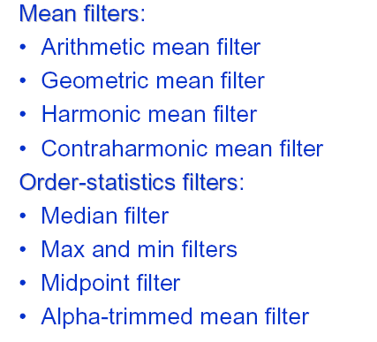
Restoration of noise-only degradation
Filters to be considered
*
1
Notes:
1

Slide 2
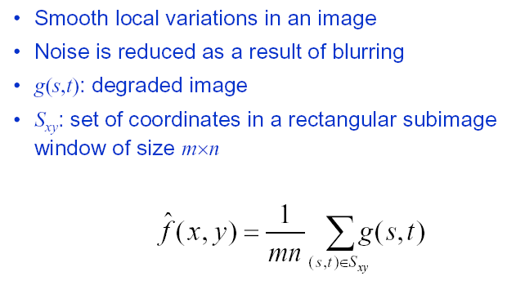
Mean Filters: Arithmetic mean filter
Causes a certain amount of blurring (proportional to the window size) to the image, thereby reducing the effects of noise.
Can be used to reduce noise of different types, but works best for Gaussian, uniform, or Erlang noise.
*
2
Notes:
2

Slide 3
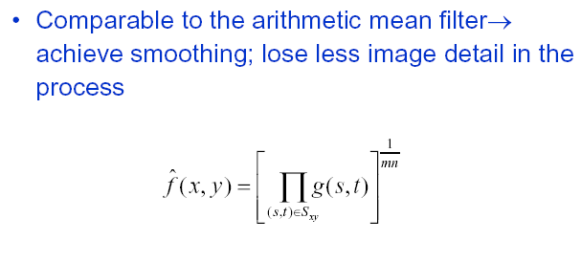
Mean Filters: Geometric mean filter
A variation of the arithmetic mean filter
Primarily used on images with Gaussian noise
Retains image detail better than the arithmetic mean
*
3
Notes:
3

Slide 4
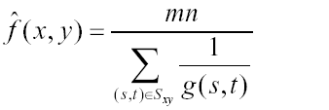
Mean Filters: Harmonic mean filter
Harmonic mean filter
Another variation of the arithmetic mean filter
Useful for images with Gaussian or salt noise
Black pixels (pepper noise) are not filtered
*
4
Notes:
4

Slide 5
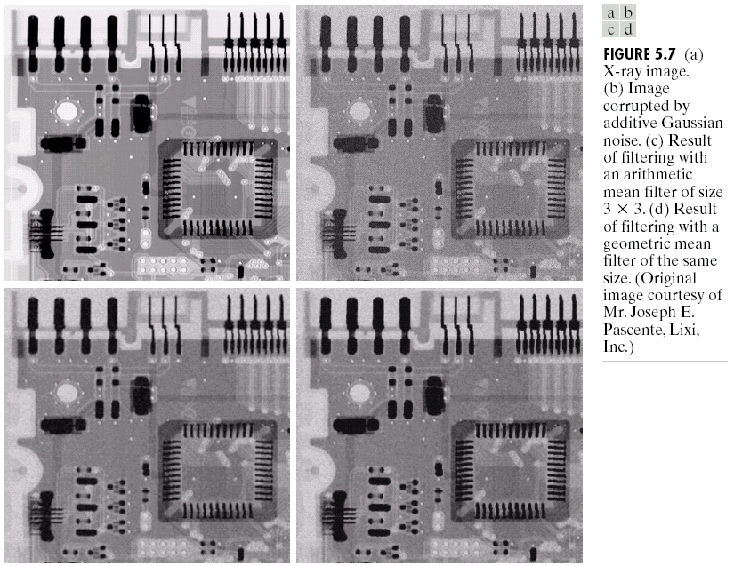
Arithmetic and geometric mean filters (example)
*
5
Notes:
5

Slide 6
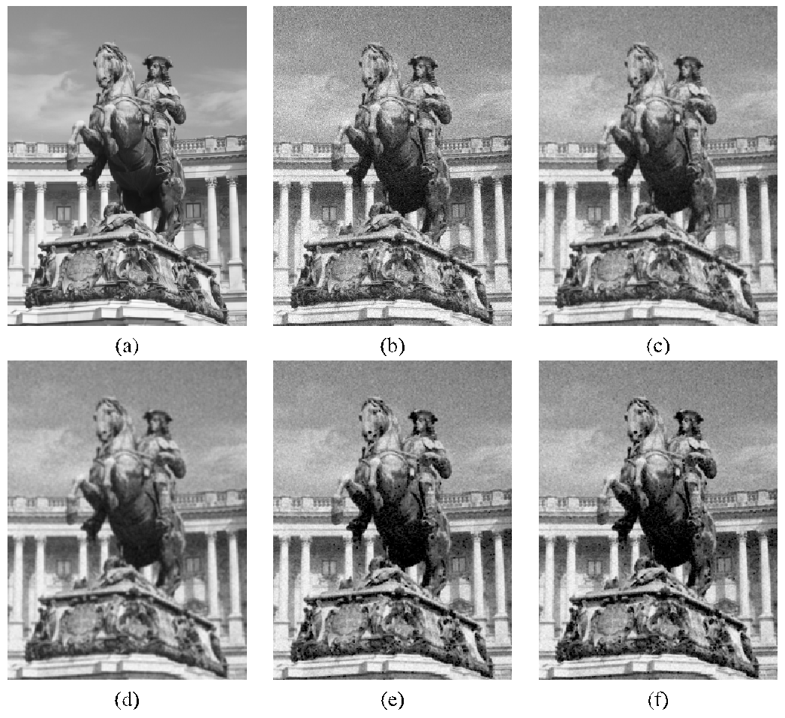
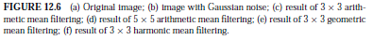
Mean Filters: Harmonic mean filter
*
6
Notes:
6

Slide 7
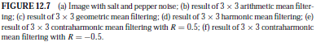
Mean Filters: Harmonic mean filter
*
7
Notes:
7

Slide 8
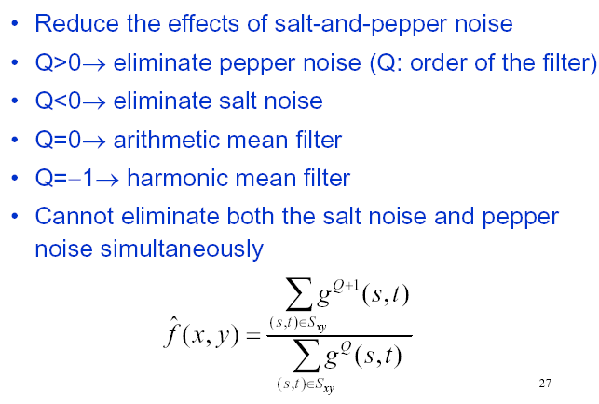
Mean Filters: Contra-harmonic mean filter
*
8
Notes:
8

Slide 9
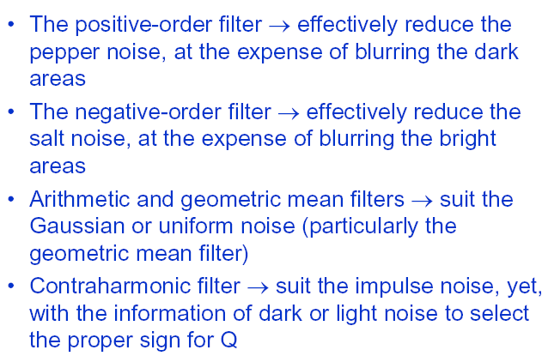
Classification of contra-harmonic filter applications
*
9
Notes:
9

Slide 10
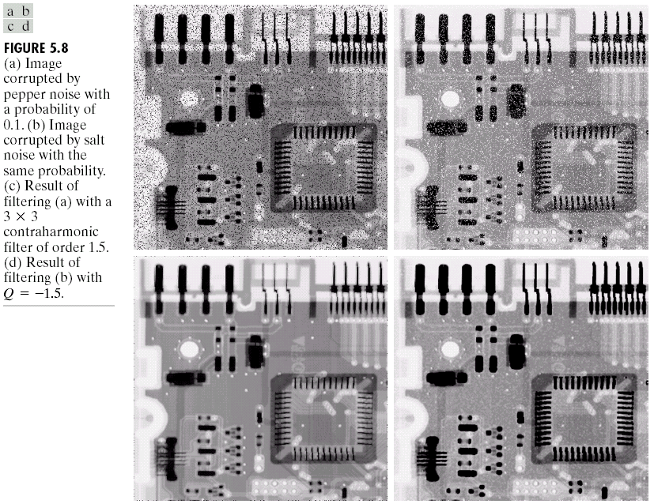
Contra-harmonic mean filter (example)
*
10
Notes:
10

Slide 11
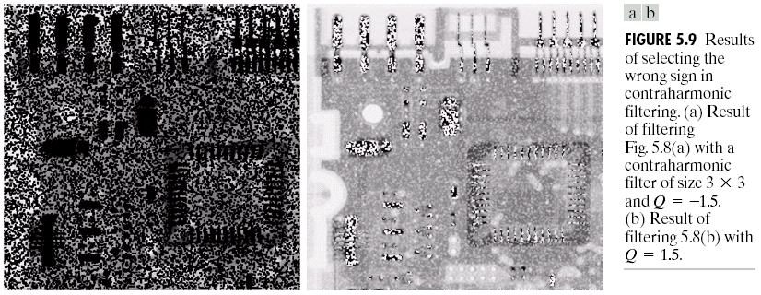
Contra-harmonic mean filter (example)
*
11
Notes:
11

Slide 12
Rank / Order Statistics Filters: Median filter
Known as Rank filters, Order filters OR Order Statistics filters
Operate on a neighborhood around a reference pixel by ordering (ranking) the pixel values and then performing an operation on those ordered values to obtain the new value for the reference pixel
They perform very well in the presence of salt and pepper noise but are more computationally expensive as compared to mean filters
*
12
Notes:
12

Slide 13
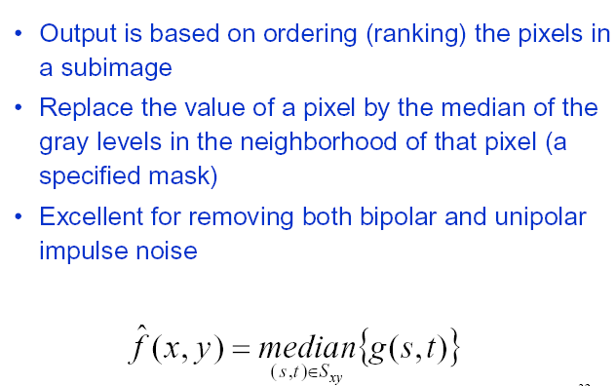
Rank / Order Statistics Filters: Median filter
*
13
Notes:
13

Slide 14
Rank / Order Statistics Filters: Median filter
Most popular and useful of the rank filters.
It works by selecting the middle pixel value from the ordered set of values within the m × n neighborhood (W) around the reference pixel.
If mn is an even number, the arithmetic average of the two values closest to the middle of the ordered set is used instead.
Many variants, extensions, and optimized implementations in the literature.
*
14
Notes:
14

Slide 15
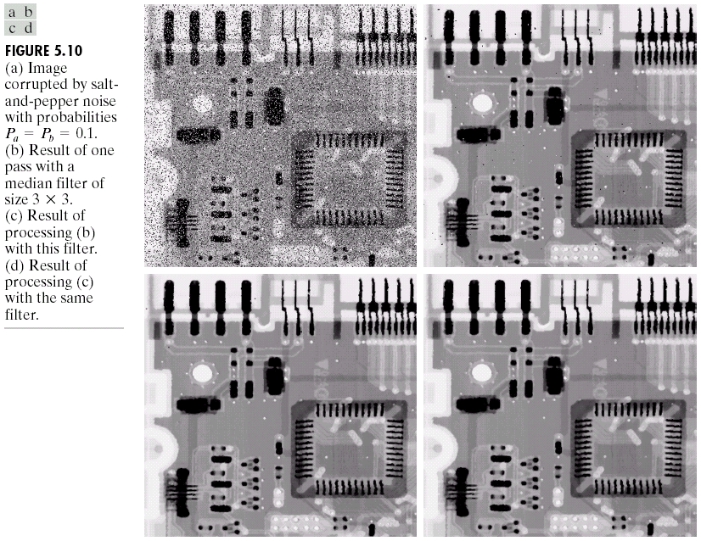
Median filter (Example)
*
15
Notes:
15

Slide 16
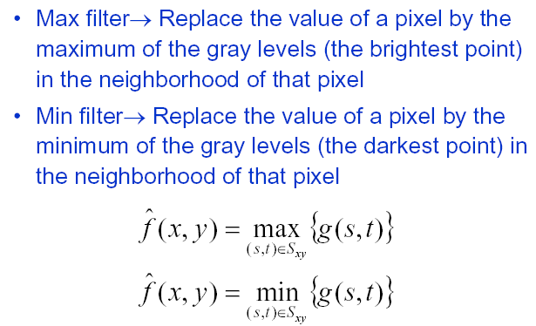
Rank / Order Statistics Filters: Max and Min filter
*
16
Notes:
16

Slide 17
Rank / Order Statistics Filters: Max and Min filter
Max filter also known as 100th percentile filter
Min filter also known as zeroth percentile filter
Max filter helps in removing pepper noise
Min filter helps in removing salt noise
*
17
Notes:
17

Slide 18

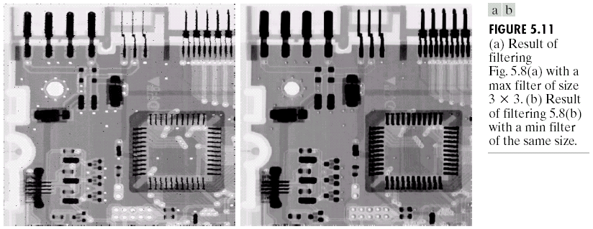
Max and Min filter (Example)
*
18
Notes:
18

Slide 19
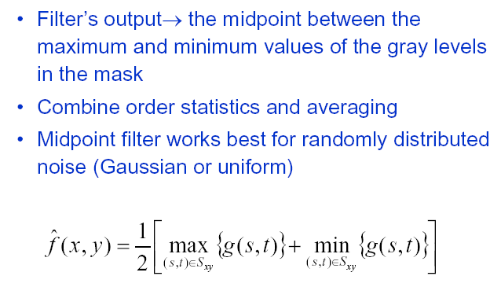
Rank / Order Statistics Filters: Midpoint filter
Calculates the average of the highest and lowest pixel values within a window
What would it do with salt and pepper noise ?
*
19
Notes:
19

Slide 20
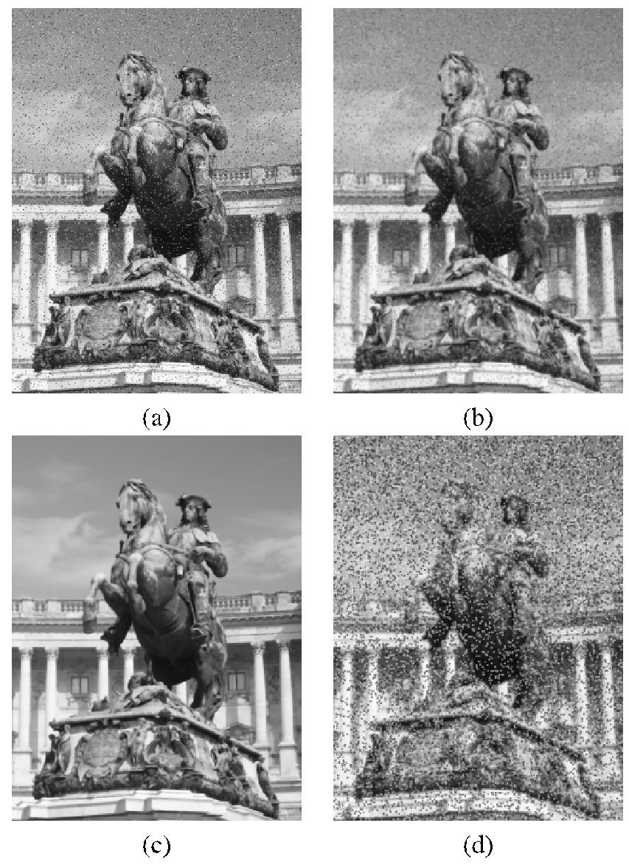
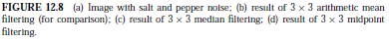
Midpoint filter (Example)
*
20
Notes:
20

Slide 21
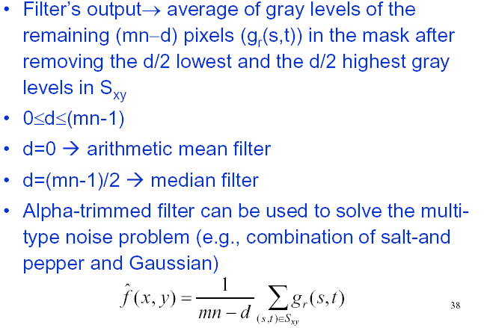
Rank/Order Statistics Filters: Alpha-Trimmed Mean Filter
*
21
Notes:
21

Slide 22
Rank/Order Statistics Filters: Alpha-Trimmed Mean Filter
Uses another combination of order statistics and averaging
Average of the pixel values closest to the median, after the α/2 lowest and the α/2 highest values in an ordered set have been excluded.
Rationale: to allow the user to control its behavior by specifying the parameter α
*
22
Notes:
22

Slide 23
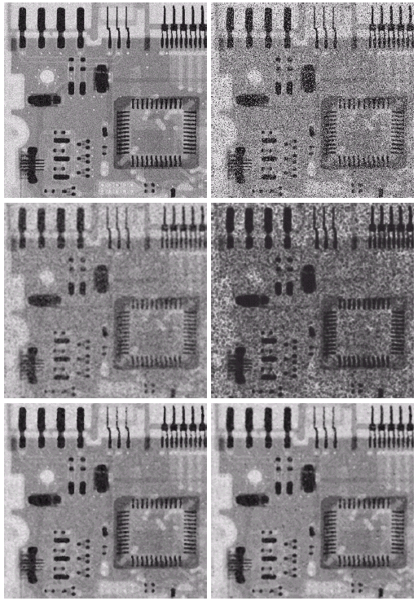
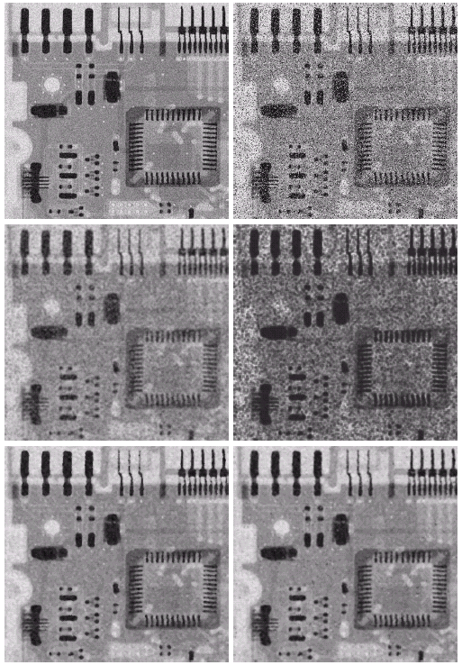
Alpha-Trimmed Mean Filter (Example)
Image corrupted by additive uniform noise
Additionally corrupted by additive salt and pepper noise
Filtered with 5x5 arithmetic mean filter
Filtered with 5x5 geometric mean filter
Filtered with 5x5 median filter
Filtered with 5x5 alpha-trimmed mean filter (d/2=5)
*
23
Notes:
23

Slide 24
Filters in MATLAB
nlfilter or colfilt
Might take long to process results
Both provide a progress bar indicator to inform to the user that the processing is taking place
colfilt is considerably faster than nlfilter
For rank filters, the IPT function ordfilt2 to create the min, max, and median filters
medfilt2
*
24
Notes:
24

Slide 25
Adaptive Filters
The behavior of adaptive filters changes according to the statistical characteristics of the image in the filter region.
This will enable the filters to have the desired response even if the image has regions with totally different characteristics.
Statistical characteristics considered : Local mean, local variance, local maximum, local minimum, local median, global mean, global variance and noise variance.
Performance of Adaptive filters is superior to that of the filters discussed till now but the price is increase in filter complexity
We will study two adaptive filters:
Adaptive local noise reduction filter
Adaptive median filter
*
25
Notes:
25

Slide 26
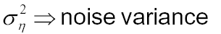
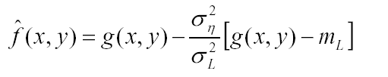
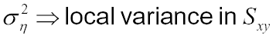
Adaptive local noise reduction filter
Filter operates on local region, Sxy
The response of the filter at any point (x,y) is based on four quantities
g(x,y), the value of the noisy image at (x,y)
, the variance of the noise which corrupts f(x,y) to form g(x,y) (?)
, the local mean of the pixels in Sxy
, the local variance of the pixels in Sxy
L
*
26
Notes:
26

Slide 27
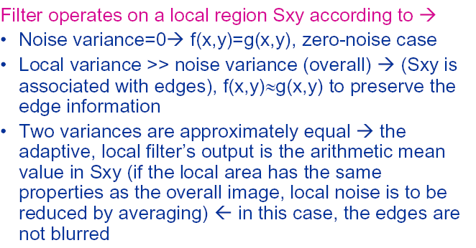
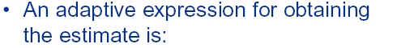
Adaptive local noise reduction filter
L
*
27
Notes:
27

Slide 28
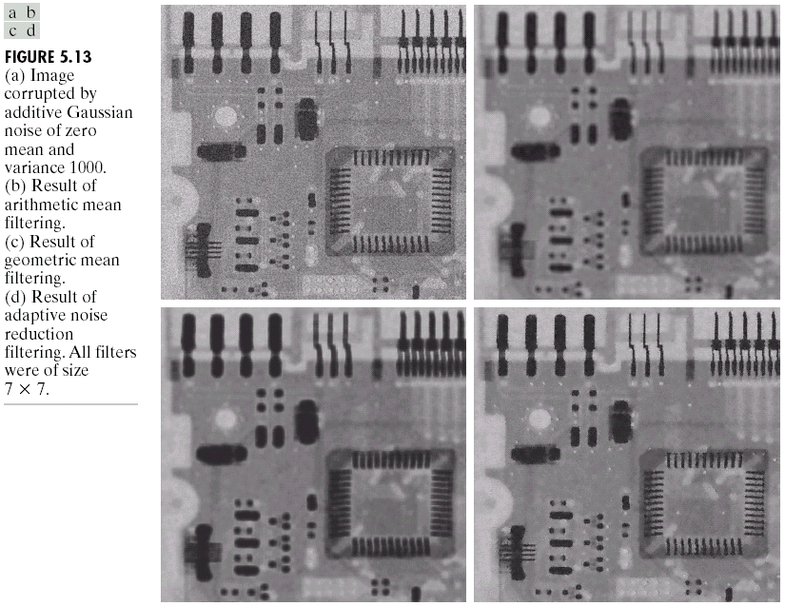
Adaptive local noise reduction filter (Example)
*
28
Notes:
28

Slide 29
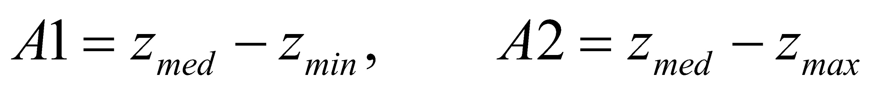
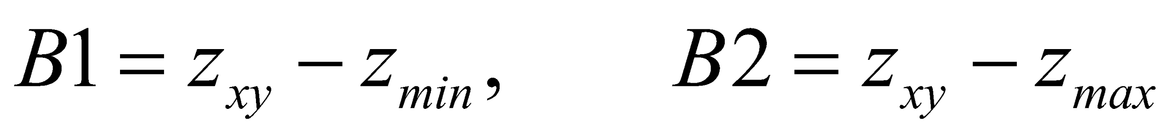
Adaptive median filter
Suppose z_{min} and z_{max} = min. and max. gray level value in S_{xy}
z_{med} = median of gray levels in S_{xy}
z_{xy} = gray level at coordinates (x, y)
S_{max} = maximum allowed size of S_{xy}
Algorithm Level A:
If A1 > 0 AND A2 <0, Go to level B
Else increase the window size
If window size ≤ S_{max} repeat level A
Else output z_{med}
Level B:
If B1 > 0 AND B2 <0, output z_{xy}
Else output z_{med}
*
29
Notes:
29

Slide 30
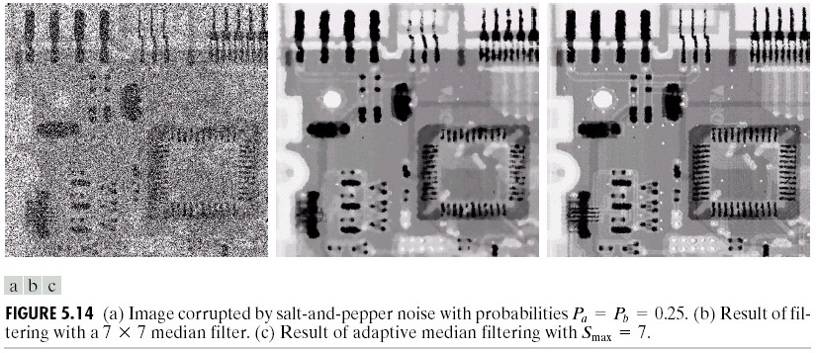
Adaptive median filter
Suitable for higher level of salt and pepper noise
Minimum loss of information
Example
*
30
Notes:
30

